Slide 1
DAT Class 10
Notes:
X MINUTES
TALKING POINTS
This is a suggested talking point.
This is another.
TEACHING TIPS
This is a suggestion for the instructor on something to do before, during or after presenting this slide.
This is another suggestion.

Slide 2
What Are Your Working Definitions of Machine Learning?

Slide 3
The Broader Notion of Building Statistical Artifacts That Become More Accurate Over Time Based on Experience
Charles Isbell, Professor, Georgia Tech

Slide 4
An Even More Mundane Definition:
Linear Algebra + Statistical Analysis, Written In Code

Slide 5
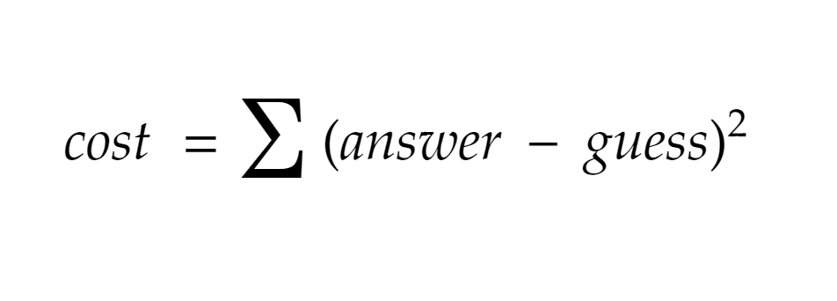
Machine Learning

Slide 6
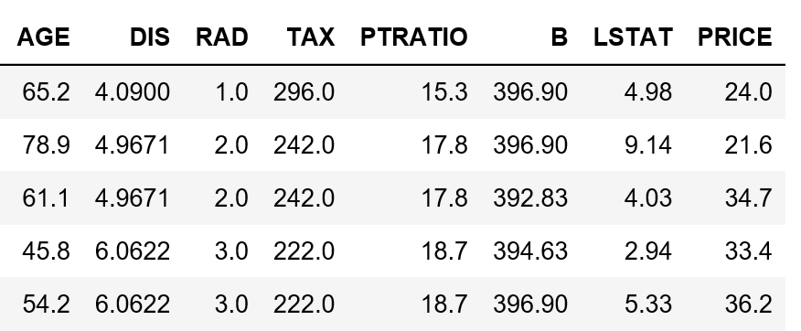
Machine Learning

Slide 7
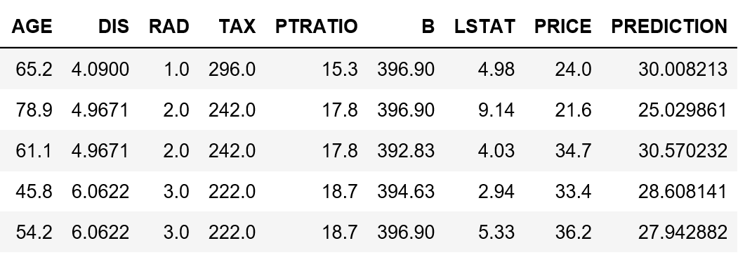
Machine Learning

Slide 8
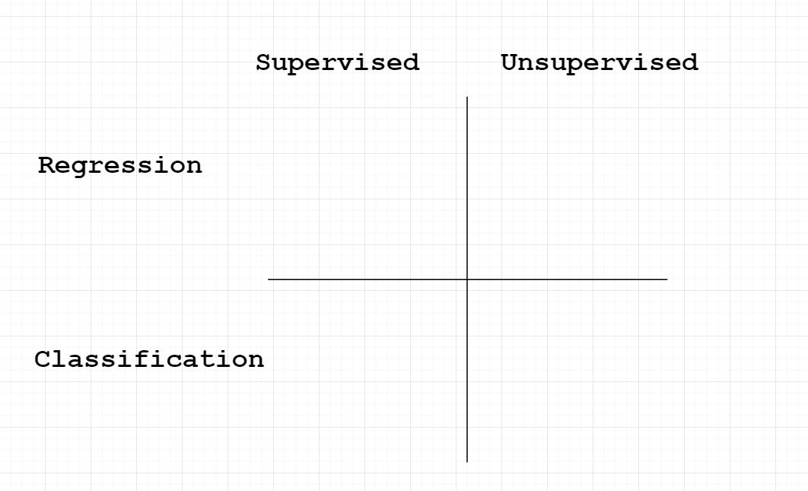

Slide 9
Linear Models
Machine Learning With Python

Slide 10
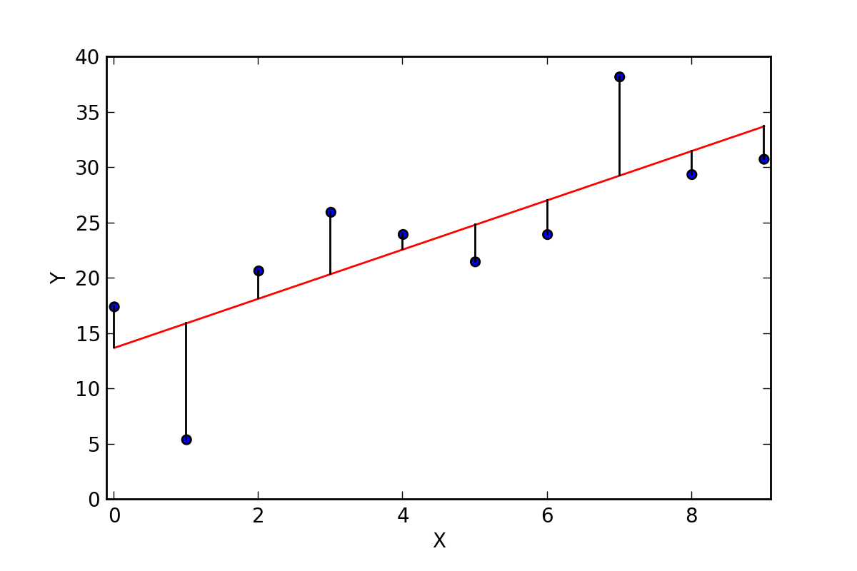
Machine Learning: Linear Models
Most common algorithm used for Machine Learning
Based on the old equation y = mx + b
Can extend this intuition to multiple variables

Slide 11
Machine Learning: Linear Models
The Good:
Very well understood
Performant
Results are interpretable: easy to understand what causes what
Work well with supervised learning problems

Slide 12
Machine Learning: Linear Models
The Bad:
Built on assumption of linear response between input and response
Sensitive to outliers
Not as accurate as more contemporary techniques
Require more data preparation than other techniques

Slide 13
Scikit Learn
Machine Learning With Python

Slide 14
Scikit Learn
The main library used to implement ML methods
Jack-of-all trades, master of none
Contains built-in techniques for most ML concepts
Is primarily built to access your own computer’s memory
Runs on a CPU, but not a GPU

Slide 15
Scikit Learn
fit() - apply the algorithm to your data
score() - evaluate your algorithm
predict() - estimate answer based on new info
get_params() - access parameters of your algorithm
set_params() - change parameters of your algorithm

Slide 16
Model Interpretation
Machine Learning With Python

Slide 17
Model Interpretation
Linear models return variable coefficients:
Represent the slope of the line for each variable
Can be thought of as the relative importance of each variable
Value means the expected change you would get in Y by changing one unit of dependent variable if everything else was set to 0

Slide 18
Model Interpretation
How would we build our predictions about our housing prices manually given the information that we have about our model?

Slide 19
Model Interpretation - Common Metrics
R² Value
How much of the change in y is described by the change in X
Captures how much better your model is than the simplest alternative -- predicting the average

Slide 20
Model Interpretation
Given the previous definition of the meaning of the slope, what’s problematic about the structure of our data?

Slide 21
Model Interpretation
Standardization:
Critical step for setting up many models correctly
Gives all numeric variables a mean of 0, and a variance of 1
Puts all weights on an equal footing
Do this by subtracting each value by its mean, and then dividing it by its standard deviation.

Slide 22
Regression Exercise #1
Create a variable X_std that is a standardized version of X.
Use X_std.describe() to double check that you did it correctly.
After that, re-run your analysis and compare your r-squared value, coefficients and intercept to their previous values.
What, if anything, changes?
Notes:
X MINUTES
TALKING POINTS
This is probably a good time to go to lunch.

Slide 23
Model Interpretation
When does standardization apply?
Linear models
Anything that uses a weight penalty (l1, l2, etc)
Any algorithm that uses gradient descent

Slide 24
Getting Linearity Out of Data
Data is not always linear. It’s fairly common to have data which might be important but doesn’t obey the ideal of linearity very closely.
Any thoughts on ways to get around this limitation?

